Slide 1
Lecture 2: Basic Syntax
Harbin Institute of Technology（Shenzhen）
School of Computer Science and Technology Zhang Meishan (mason.zms@gmail.com)
Copyright：Harbin Institute of Technology，Su Xiaohong， sxh@hit.edu.cn
Notes:
Now Let’s begin today’s new lecture on the basic syntax of C++ programming.

Slide 2
Overview
Variable
Constants
Memory and size
Basic statements
Notes:
We’ll be exploring fundamental elements such as variables, constants, memory allocation, and basic statements in C++. Understanding these foundational concepts will help you build more complex programs as we move forward.

Slide 3
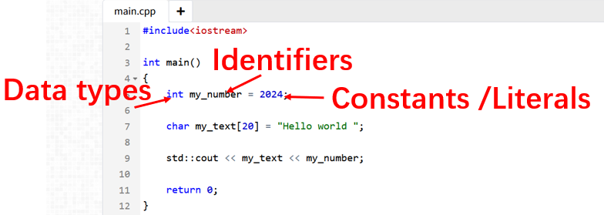
An Opening Example
Basic Syntax: Data, Statements, Operators, Include, Names, ……
Notes:
Basic Syntax in C++ covers Data, Statements, Operators, Include statements, and Names. Here is an example showing the use of data type, identifier, and constant, which we will explain later.

Slide 4
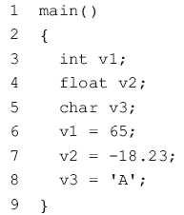
2.1 Variables
Data in C++： Variables ； Constants
Variables：can vary its values in a program
main( ) marks the point where a C++ program starts to execute and must appear once
defines the name and type of variables
assign value to variables
The program statements are contained within the braces { and }
Each statement ends with ’ ;’
Notes:
First, let’s talk about variables.
C++ uses variables and constants to store data. A variable can change its value throughout the program.
We begin with an example that introduces basic C++ syntax. Here, you’ll see data statements, operators, and the structure of a basic C++ program. Remember that every C++ program must have a main() function and it must appear once and only, as this is where execution starts. Each line of code or statement is written inside curly braces {} and must end with a semicolon ;
This structure is critical to creating any C++ program.
These statements define the name and type of variables and assign value to variables

Slide 5

2.1 Variables
A variable must be defined before it can be used. A variable is defined by giving it a data type and a name
A variable can be given any name, called an identifier in C++, provided it is within the following rules
An identifier can only be constructed using letters, numerals or underscores (_).
An identifier must start with a letter or an underscore.
An identifier cannot be a C++ keyword. A keyword is a word that has a special meaning.
An identifier can contain any number of characters, but only the first thirty-one characters are significant to the C++ compiler.
A variable is like a box in the memory of the computer.
Notes:
In C++, a variable is like a box in your computer’s memory where you can store data. There are different types of data, such as integers, floats, and characters, and each type of data requires its own variable.
When we define a variable, we tell C++ what type of data it can hold. This process is called variable declaration. For example:
```
int age = 25;
```
Here, int is the data type, and age is the variable name. We’ve assigned it the value of 25. Keep in mind, variable names, or identifiers, can contain letters, numbers, and underscores but must start with a letter or an underscore.
And it cannot be a keyword in C++. For example, you can't name your variable 'int' or 'return' because these are reserved words.
Identifiers are also case-sensitive, this means Age and age would be considered two different variables.

Slide 6
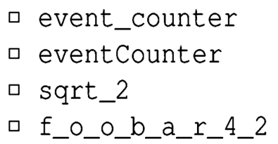


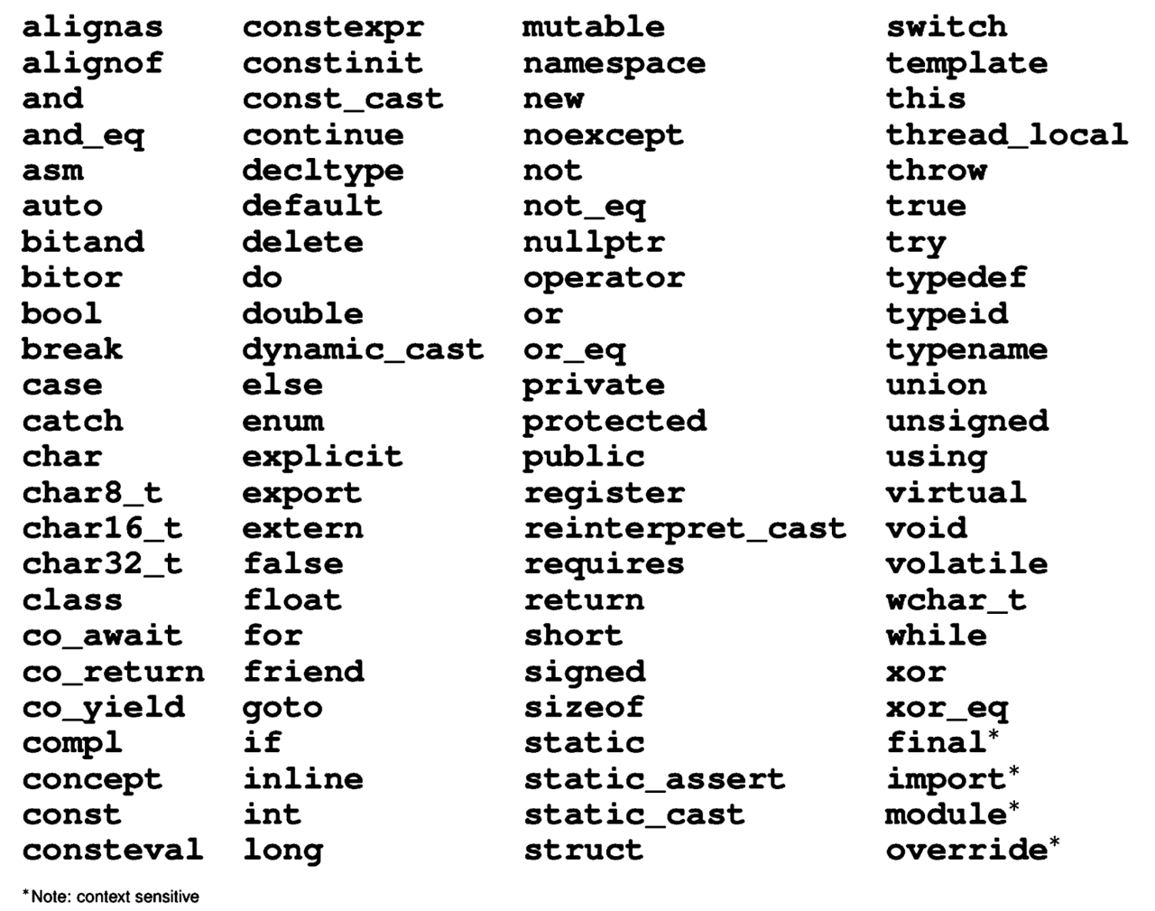
2.1 Variables
Example of valid identifiers:
Identifiers are case sensitive：
Identifiers cannot be any of reserved keywords：
Notes:
Here are some Examples of valid identifiers. And as is shown in the picture, identifiers cannot be any of reserved keywords because they have special meaning.

Slide 7
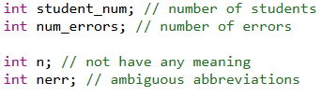

2.1 Variables
Identifiers are better to be with good naming convention.
Function naming, variable naming, and file naming should be descriptive, with fewer abbreviations. Use descriptive naming wherever possible to make code easy to understand.
Camel case： The first letter of the variable name is lowercase, and the first letter of each subsequent word is capitalized without underscores.
Notes:
While you can name your variables anything that follows the above rules, it's better to follow good naming conventions. When naming variables, it’s important to use names that describe their purpose. This makes your code easier to understand. For example, instead of just calling a variable x, it's more helpful to name it something like ‘student_num’. This way, anyone reading your code can easily understand its purpose.
There are some other common naming styles in C++: Camel Case – Where each word is capitalized except for the first one, like numberErrors.

Slide 8


2.1 Variables
Identifiers are better to be with good naming convention.
Underscore case：Words are separated by underscores. Variable names are usually in all lowercase.
Use easily understandable abbreviations: If abbreviations are necessary to simplify variable names, ensure that the abbreviations are common, easily understandable, and comment in the code to explain their meanings.
Notes:
Underscore Case – Where words are separated by underscores, like number_of_apples.
Remember, well-named variables make your code cleaner and easier to read, especially when working in teams or revisiting your code after a long time. And descriptive names make your code more readable.

Slide 9
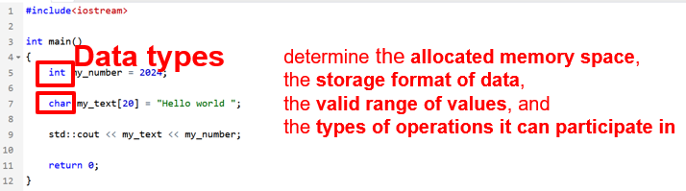

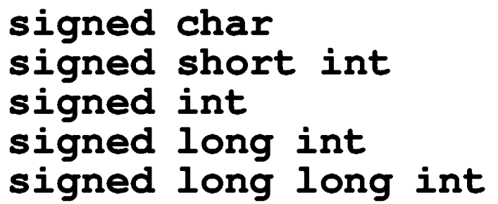
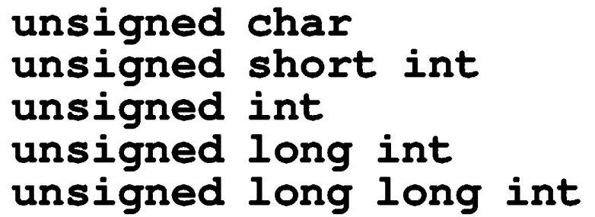
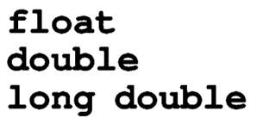

2.1 Variables
Data types
Boolean type
Integer type (signed and unsigned)
Floating-point types
Character types
Notes:
Now, let's move on to data types. In C++, we have several basic data types, including
boolean,
integer (both signed and unsigned),
floating-point numbers,
and characters.
It's crucial to understand the differences between these types because the data type determines the allocated memory space, the storage format of data, the valid range of values, and the types of operations it can participate in. For example, an int typically requires 4 bytes, while a char usually needs 1 byte.

Slide 10
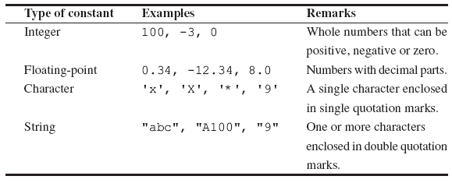
2.2 Constants
Constants：does not change its value in a program.
int
float
char
string
Notes:
Now let’s move on to constants. A constant is a type of variable that doesn’t change its value once it has been set. You define constants when you need fixed values throughout your program. Here’s an example:
const int maxStudents = 30;
In this case, maxStudents will always be 30, and you can’t change it later in the code. It’s useful for things like defining limits or settings that remain unchanged.
Constants can be integers, floats, characters, or even strings.

Slide 11
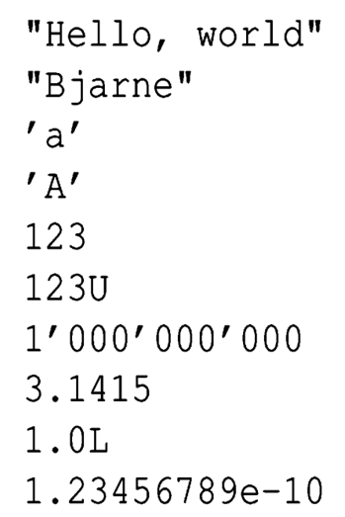
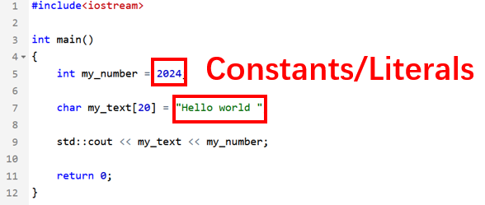

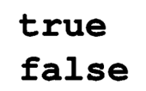

2.2 Constants
Boolean literals:
Pointer literal:

Slide 12
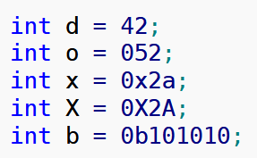
Integer literal types
2.2 Constants
Prefixes which indicates the base. For example, 0x10 indicates the value 16 in hexadecimal having prefix 0x.
Decimal-literal (base 10):- a non-zero decimal digit followed by zero or more decimal digits(0, 1, 2, 3, 4, 5, 6, 7, 8, 9). For example, 56, 78.
Octal-literal (base 8):- a zero followed by zero or more octal digits(0, 1, 2, 3, 4, 5, 6, 7). For example, 045, 076, 06210.
Hex-literal (base 16):- 0x or 0X followed by one or more hexadecimal digits(0, 1, 2, 3, 4, 5, 6, 7, 8, 9, a, A, b, B, c, C, d, D, e, E, f, F). For example, 0x23A, 0Xb4C, 0xFEA.
Binary-literal (base 2):- 0b or 0B followed by one or more binary digits(0, 1). For example, 0b101, 0B111.
Question: what are the values stored inside the following variables?
Notes:
There are also different kinds of integer literal types in C++. For example, a number with a 0x prefix, like 0x10, represents the value 16. You can also represent numbers in octal or binary.
Question: Let’s do a test. what are the values stored inside the following variables?
1.int d = 42;
This is a standard decimal (base 10) assignment.
Value of d = 42.
2. int o = 052;
This uses the octal (base 8) notation because it starts with a 0.The octal value 052 is equivalent to the decimal value 42.
Value of o = 42.
3.int x = 0x2a;
This uses hexadecimal (base 16) notation, indicated by 0x. The hexadecimal value 2a is equivalent to the decimal value 42.
Value of x = 42.
4. int X = 0X2A;
This also uses hexadecimal (base 16) notation, indicated by 0X. The case of 'x' does not matter.
The hexadecimal value 2A is equivalent to the decimal value 42.
Value of X = 42.
5.int b = 0b101010;
This uses binary (base 2) notation, indicated by 0b. The binary value 101010 is equivalent to the decimal value 42.
Value of b = 42.

Slide 13
2.2 Constants
Integer literal types
Suffixes which indicates the data type.
For example, 12345678901234LL indicates the value 12345678901234 as an long long integer having suffix LL.
int:- No suffix are required because integer constant are by default assigned as int data type.
unsigned int: character u or U at the end of integer constant.
long int: character l or L at the end of integer constant.
unsigned long int: character ul or UL at the end of integer constant.
long long int: character ll or LL at the end of integer constant.
unsigned long long int: character ull or ULL at the end of integer constant.

Slide 14
2.2 Constants
Integer literal types
Suffixes which indicates the data type.
For example, 12345678901234LL indicates the value 12345678901234 as an long long integer having suffix LL.
int:- No suffix are required because integer constant are by default assigned as int data type.
unsigned int: character u or U at the end of integer constant.
long int: character l or L at the end of integer constant.
unsigned long int: character ul or UL at the end of integer constant.
long long int: character ll or LL at the end of integer constant.
unsigned long long int: character ull or ULL at the end of integer constant.

Slide 15
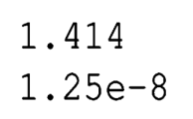
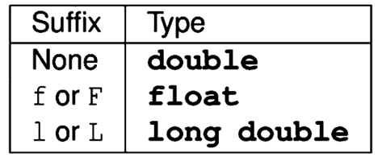
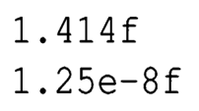
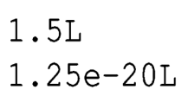
Floating-point literal types
2.2 Constants
1.25 × 10⁻⁸
s × r ^{j}
Significand s
Exponent j
Radix (base) r
1.25 × 10⁻⁸
1.25 × 10⁻²⁰
Notes:
Similar to integer literals, floating-point numbers in C++ can also have literal types. These follow the scientific notation format where a number is represented as a significand, radix, and exponent. This notation helps manage very large or very small numbers efficiently. You will see this used often in calculations that involve decimal points.
All right, that's it for the first part of today's lecture! We've gone through the basics of variables, constants, and data types. In the next part, we’ll look at memory, size, and more about basic statements in C++. Feel free to ask any questions you have so far.

Slide 16
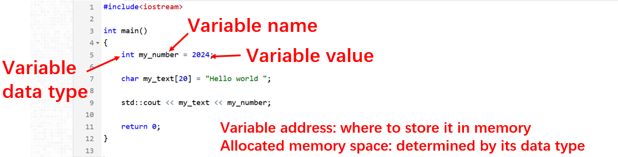
Review: variable properties
2.3 Memory and Size
Notes:
Now, let’s move on to memory and size. Every variable in C++ occupies a certain amount of memory, where is saved, and this size depends on the type of the variable. Variables are stored at specific memory addresses, and this is important when working with pointers and memory manipulation in advanced topics.

Slide 17
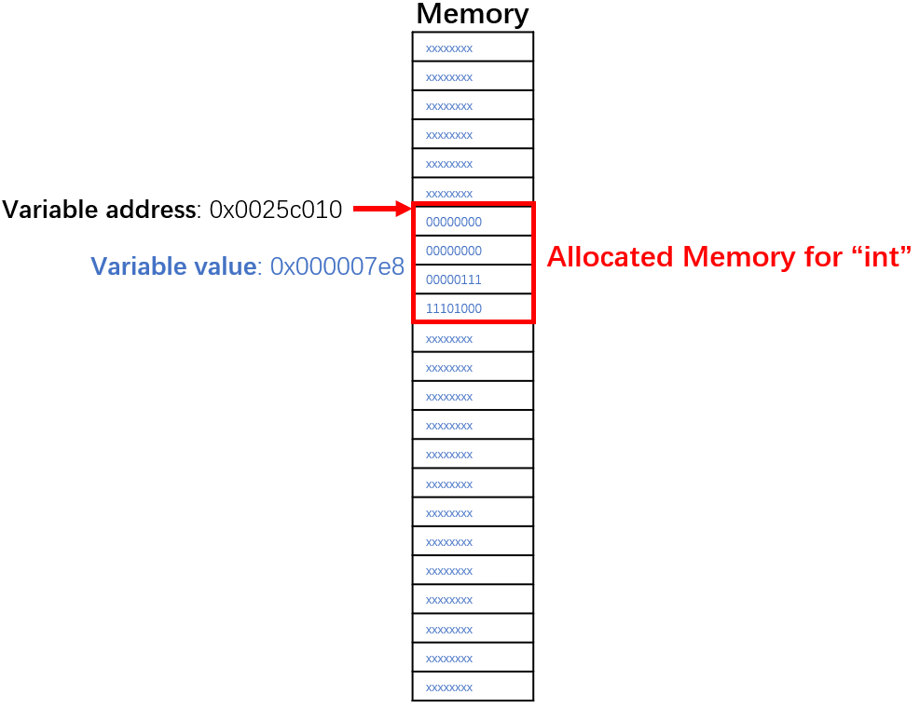
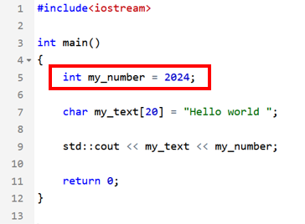
2.3 Memory and Size
Variable memory
First address and size

Slide 18
2.3 Memory and Size
Boolean type
Integer type
(signed and unsigned)
Floating-point types
Character types
(Note that char is distinct type from signed char and unsigned char)
1 Bytes
Typical size (differs by systems)
1 Bytes
2 Bytes
4 Bytes
8 Bytes
8 Bytes
4 Bytes
8 Bytes
16 Bytes
1 Bytes
Notes:
In C++, different data types occupy varying amounts of memory. For example, a boolean type usually takes 1 byte, while integers might take 2, 4, or 8 bytes, depending on the system architecture. Floating-point types also vary, typically taking 4 or 8 bytes. You should be aware of this when writing programs, especially when memory is limited or when precision matters.

Slide 19
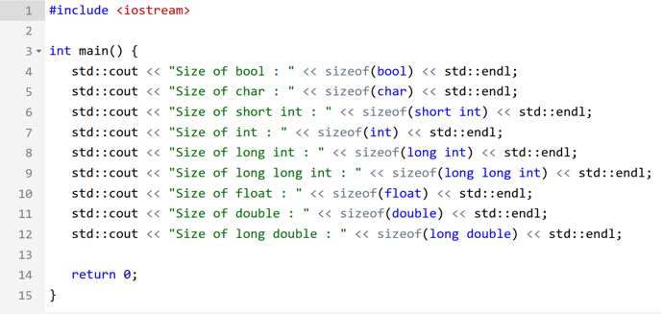
2.3 Memory and Size
sizeof operator determines the size, in bytes, of a variable or data type;
Can be used to get the size of classes, structures, unions and any other user defined data type.
Notes:
To determine the size of any data type or object in bytes, we use the ‘sizeof’ operator. This is particularly useful when working with large data structures, as it allows you to calculate how much memory a particular object or class will consume. You can use it with basic types, user-defined classes, structures, and more.

Slide 20
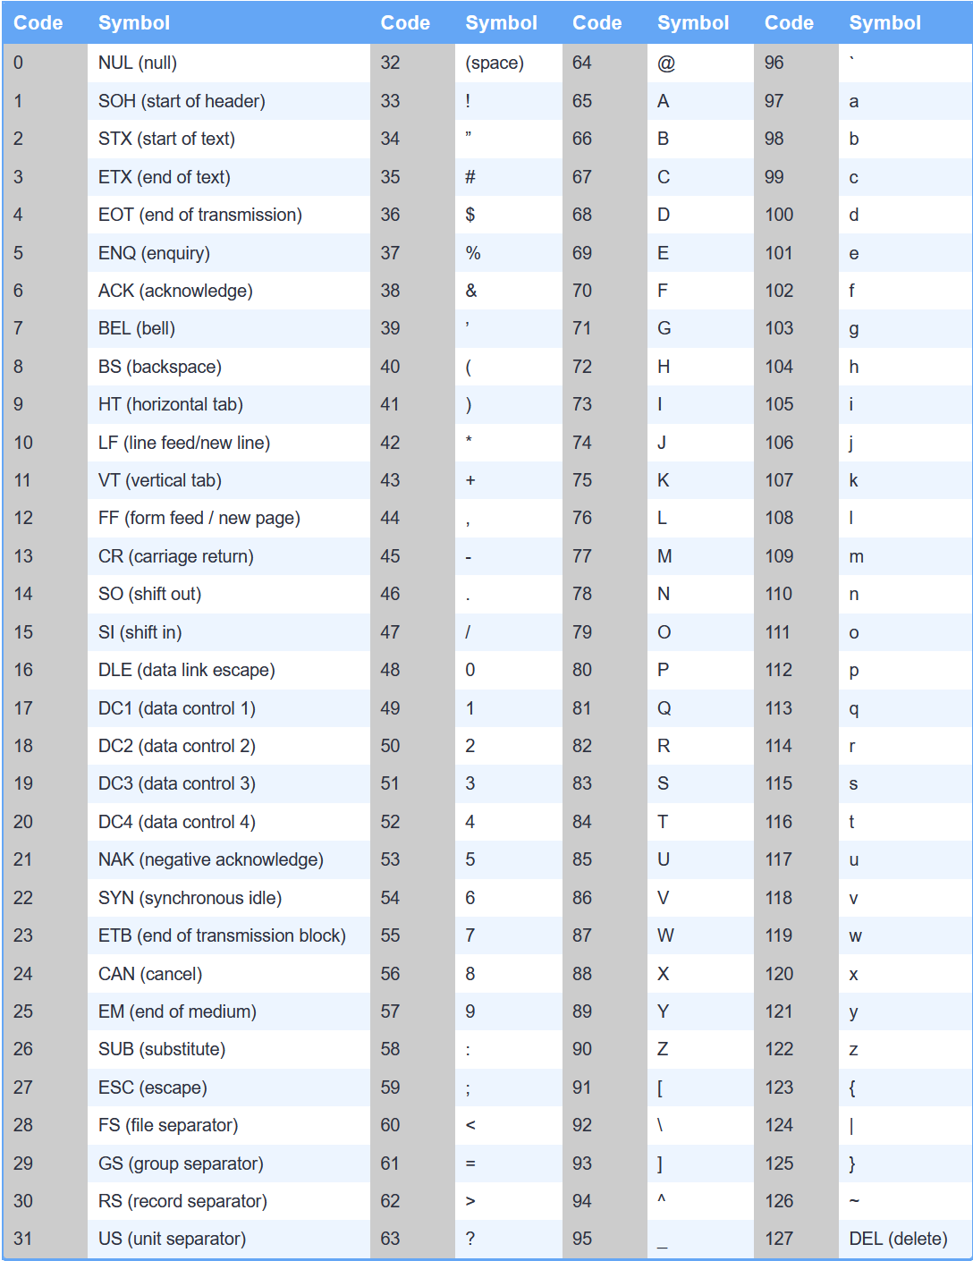
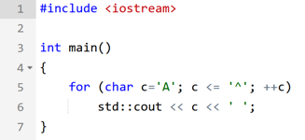
2.3 Memory and Size
Character encoded in 1 Byte
ASCII stands for American Standard Code for Information Interchange, and it defines a particular way to represent English characters (plus a few other symbols) as numbers between 0 and 127
Notes:
When dealing with characters, C++ uses ASCII encoding by default, which represents characters as numbers between 0 and 127. Each character typically takes up 1 byte of memory. Understanding encoding is important when dealing with text data and file I/O.

Slide 21
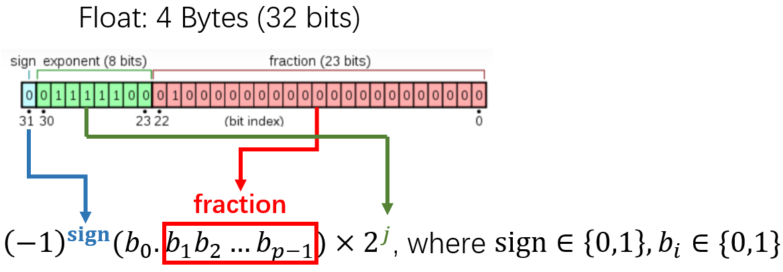
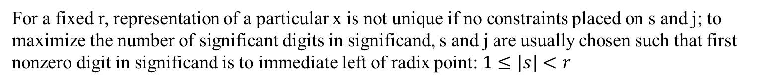
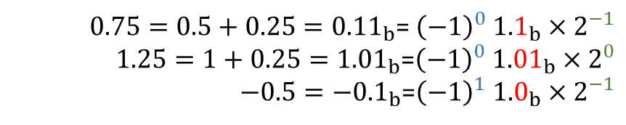
2.3 Memory and Size
Floating-point types
A floating-point number x = s × r ^{j}
Significand s with p significant bits
Exponent j
Radix r, and typically r = 2
$0.75=0.5+0.25={0.11}_{b}$= ${\left(−1\right)}^{0} {1.1}_{b}×2^{−1}$
$1.25=1+0.25={1.01}_{b}$=${\left(−1\right)}^{0} {1.01}_{b}×2^{0}$
$−0.5=−{0.1}_{b}$=${\left(−1\right)}^{1} {1.0}_{b}×2^{−1}$
For a fixed r, representation of a particular x is not unique if no constraints placed on s and j; to maximize the number of significant digits in significand, s and j are usually chosen such that first nonzero digit in significand is to immediate left of radix point: $1≤\left|s\right|<r$
Notes:
Then, Let’s talk about floating-point numbers. These numbers are represented in memory as a combination of a significand, radix, and exponent. The radix is usually base 2 in C++. This representation allows us to work with a wide range of values, but keep in mind that floating-point precision is limited. For example, not all decimal numbers can be represented exactly due to binary limitations. You will learn the method of floating-point number representation in your future study.

Slide 22
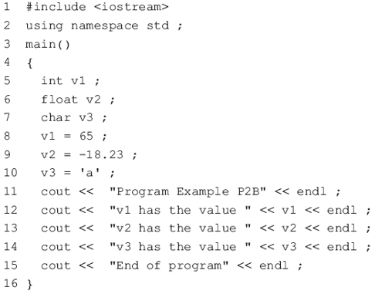
2.4 Basic Statements
Simple output to the screen
Never forget the semicolon!
#include <iostream.h>：
make iostream.h available to the program.
It contains some C++ statements to make it easy to perform input and output
using namespace std: available std available the program, otherwise std::cout, std::endl
cout： sends the data to cout
the stream insertion operator << is used to insert a string of characters into the output stream object cout
a string of characters: letters or numbers enclosed in “ ”
The variable name is not in quotation marks
endl： go the start of the next line on the screen
Notes:
Now, we’ll move on to output statements. In C++, you’ll frequently need to display output to the user or get input from them. To print something on the screen, we use cout, which is part of the iostream library. You’ll also need to use the << operator to insert data into the output stream. Remember to always end each statement with a semicolon. For example, cout << "Hello, World!" << endl; prints a string followed by moving to a new line.
Note that Never forget the semicolon!

Slide 23
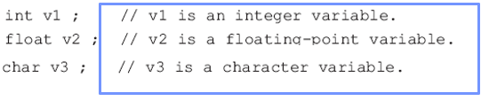
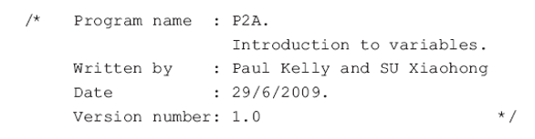
2.4 Basic Statements
Comments
Comments are added to a C++ program to make it more readable for the programmer
completely ignored by the compiler.
comments start with the characters // and end at the end of the line.
C-style comments begin with the characters /* and end with the characters */ is also used in C++
Get into the habit of using comments !
Bad comments can lead to confusion !
Notes:
Comments are important for making your code readable and maintainable. In C++, single-line comments start with //, and multi-line comments are enclosed within /* */. While comments are ignored by the compiler, they are crucial for explaining your code to others or reminding yourself what your code does when you revisit it.

Slide 24

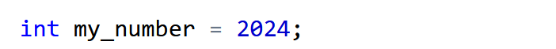

2.4 Basic Statements
Variable definition operations
Definition introduces identifier for variable
Each identifier must be declared before it can be used
Variables of the same type can be declared together
Notes:
When you define a variable, you introduce its identifier and type to the compiler. This is a declaration. For example,
‘ int my_number; ’
tells the compiler that you are declaring a variable called ‘my_number’ of type integer. You can declare multiple variables of the same type in one line, separated by commas, like int a, b, c;.
After declaring a variable, you need to assign it a value, which is known as initialization. For instance,
int my_number = 2024;
assigns the value 2024 to the variable my_number.

Slide 25
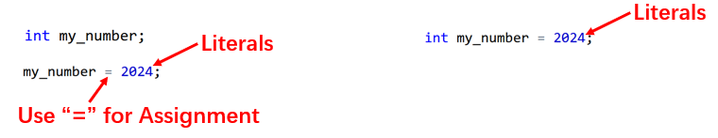
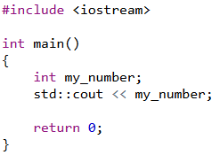
2.4 Basic Statements
Variable assignment operations
Initialize a variable
What is value stored inside a variable if it is declared but not initialized?
Using the values of uninitialized variables can lead to unexpected results
C/C++ does not automatically initialize most variables to a given value, the default value is whatever (garbage) value happens to already be in that memory address!
Notes:
In C++, the ‘=’ symbol is used for assignment. It is important to note that this is not the same as mathematical equality. Instead, it assigns the value on the right-hand side to the variable on the left-hand side.
The value 2024 is an integer literal. A literal is a fixed value written directly in the code, and here it’s the number 2024. The literal is assigned to the variable my_number, which means that after this line executes, my_number holds the value 2024
In the right picture, we are both declaring and initializing the variable my_number in a single line. This is often preferred in C++ because it is more concise and avoids potential issues with uninitialized variables.
If you don’t initialize a variable, it contains a 'garbage' value, which could lead to unpredictable behavior in your program.
Because C++ does not automatically initialize most variables to a given value, the default value is whatever (garbage) value happens to already be in that memory address!

Slide 26
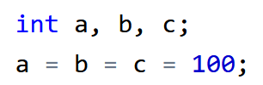

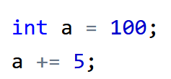
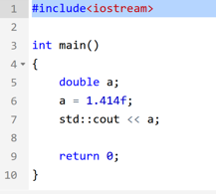
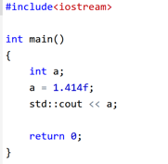
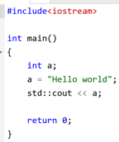
2.4 Basic Statements
Variable assignment operations
Multiple assignment
Compound assignment
(more details in next lecture)
Consistency of data types
Notes:
You can also assign the same value to multiple variables in one line using multiple assignments. For example,
a = b = c = 100;
assigns the value 100 to all three variables.
a = ( b = (c =100) );
This is just a different way of writing the same chained assignment but with parentheses () to show the order in which the assignments are performed explicitly.
Just like before:
c = 100 is evaluated first, setting c to 100.
The result of c = 100 is then assigned to b, so b becomes 100.
Finally, the result of b = 100 is assigned to a, so now all three variables (a, b, and c) hold the value 100.
Compound assignments, like a += 5;, are shorthand for a = a + 5;. We’ll explore compound assignments in more detail in the next lecture.
You should pay attention to the Consistency of data types.
Case1: a is declared as a double float number, and you are assigning the value 1.414f.
double is short for "double precision floating-point number". It is used to represent real numbers (numbers with a decimal point) that require more precision than the float type can provide.
A float typically uses 32 bits (4 bytes) to store a floating-point number.
A double typically uses 64 bits (8 bytes), allowing it to store numbers with a higher degree of precision and a larger range. So, it will output 1.414 naturally.
Case2: Here, a is declared as an int (integer), and you are assigning the value 1.414f, which is a floating-point number (with the f indicating it is a float).
This is an example of inconsistent data types, because a float value is being assigned to an int. What will happen is that C++ will truncate the floating-point value, meaning only the whole number part will be stored, and the decimal part will be lost. So, a will become 1, not 1.414.
Case 3:
Here, the variable a is declared as an int, but it is being assigned a string value ("Hello world").
This is an example of completely incompatible data types. C++ cannot convert a string to an integer. If you try to compile this, you’ll get a type mismatch error.
In C++, it's crucial to maintain type consistency between variables and their assigned values to avoid such errors. In this case, a should be of type std::string if the intent is to store text.

Slide 27
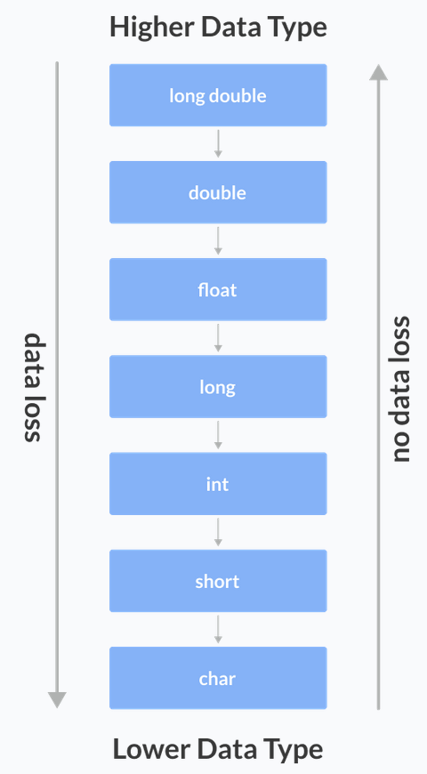
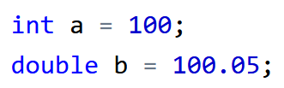



2.4 Basic Statements
Data type conversion
Automatic conversion
Explicit conversion
Conversion from int to double
Conversion from double to int Data Loss!
C-style Type Casting
Notes:
Data type conversion is another important topic. In C++, conversions can be automatic or explicit. For example, if you assign an int to a double, the conversion happens automatically. However, converting a double to an int can result in data loss because the fractional part is discarded. To perform explicit conversions, we can use C-style casting like (int) 3.14, which converts the floating-point number to an integer.

Slide 28

Thank you for
your attention !
Q&A
ZhangMeiShan
Notes:
That is today’s lecture. We’ve covered some critical concepts like variables, constants, memory, and basic statements. These are foundational for writing efficient and understandable C++ code.
Make sure you practice these concepts in your assignments, as they’ll form the basis for everything else you do in C++.

Slide 29
Homework
1.Which of the following are valid C++ variable names? If valid, do you think the name is good mnemonic(i.e. reminds you of its purpose)?
(a) stock_code (b) money$ (c) Jan_Sales (d) X-RAY
(e) int (f) xyz (g) la (h) invoce_total
(i) John’s_exam_mark
2.Which of the following are valid variable definitions?
(a) integer account_code; (b) float balance; (c)decimal total;
(d) int age; (e) double int;
Notes:
Here is the homework for this lecture, composed of four questions.

Slide 30
Homework
3.Write variable definitions for each of the following:
(a) integer variables number_of_transactions and age_in_years
(b) floating-point variables total_pay, tax_payment, distance and average
(c) long integer variables record_position and count
(d) a character variable account_type
(e) a double variable gross_pay

Slide 31
Homework
4. Write a C++ program to assign values to the variables in exercise 3 and display the value of each variable on a separate line.

